Slide 1
Introduction
MGCV Skill training Session

Slide 2



A minimal statistics intro
What is a LM/GLM/GAM?
Is it working??
Ohh no…

Slide 3
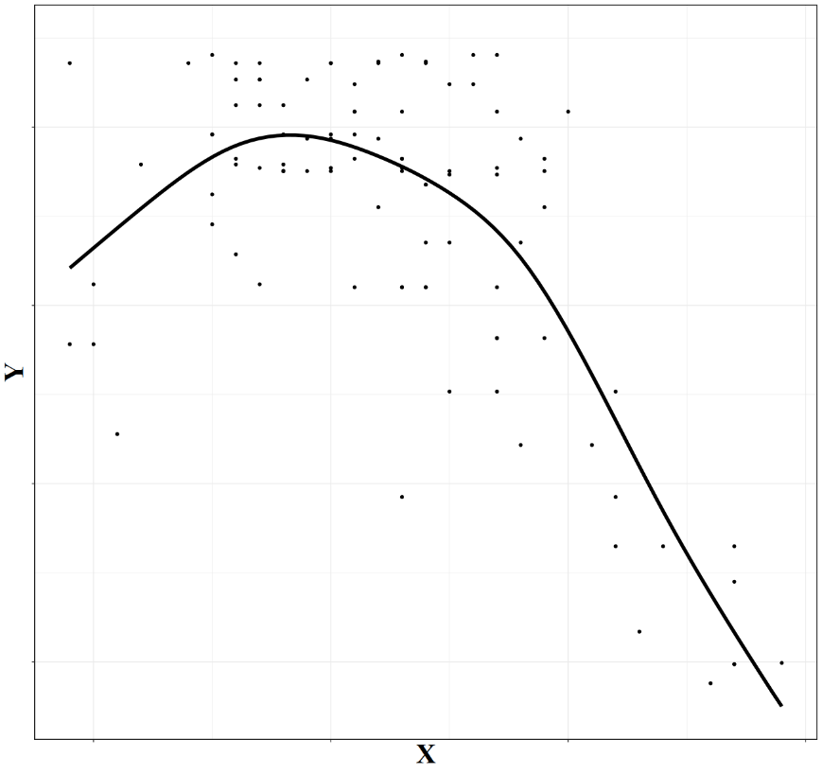
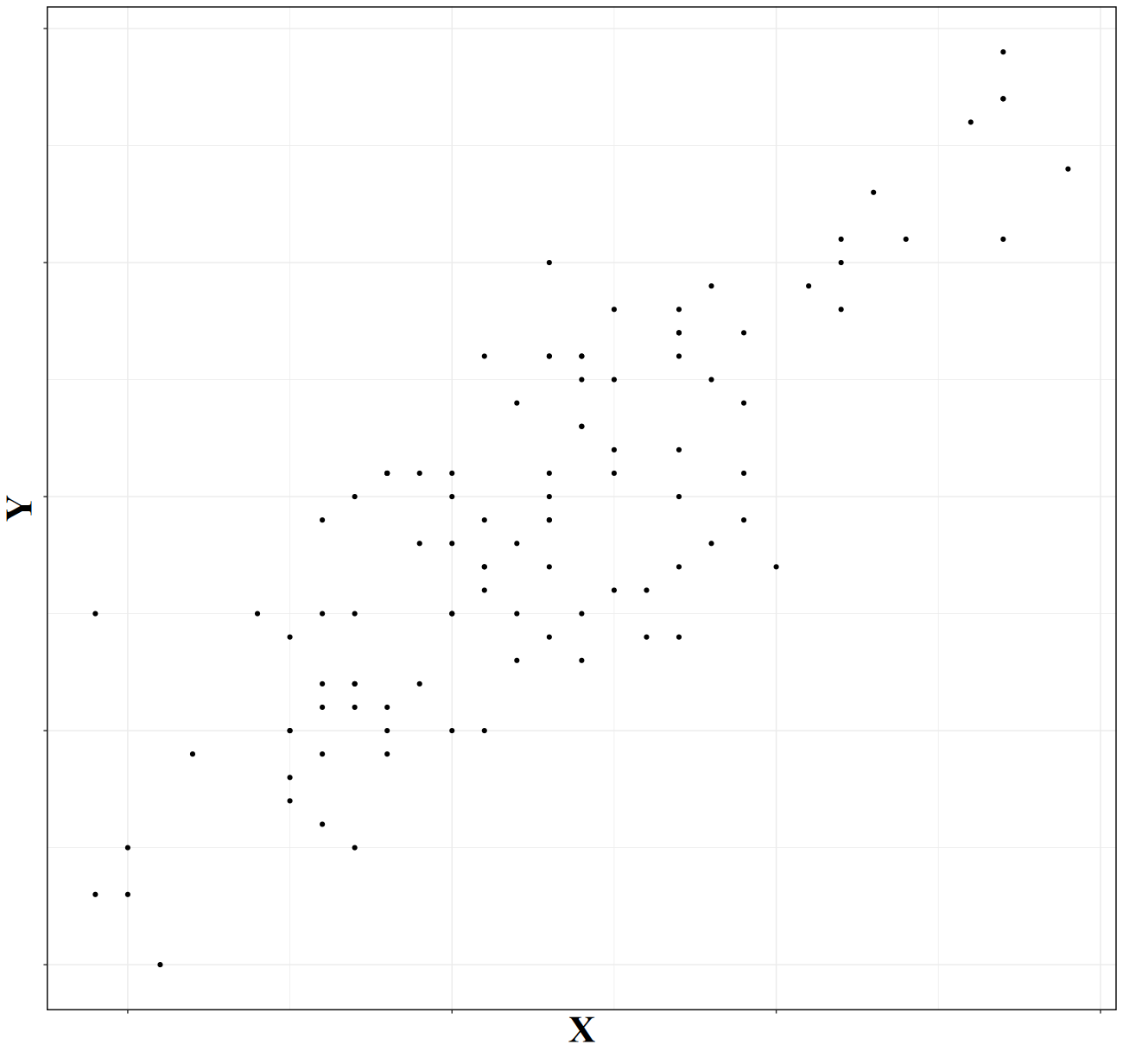
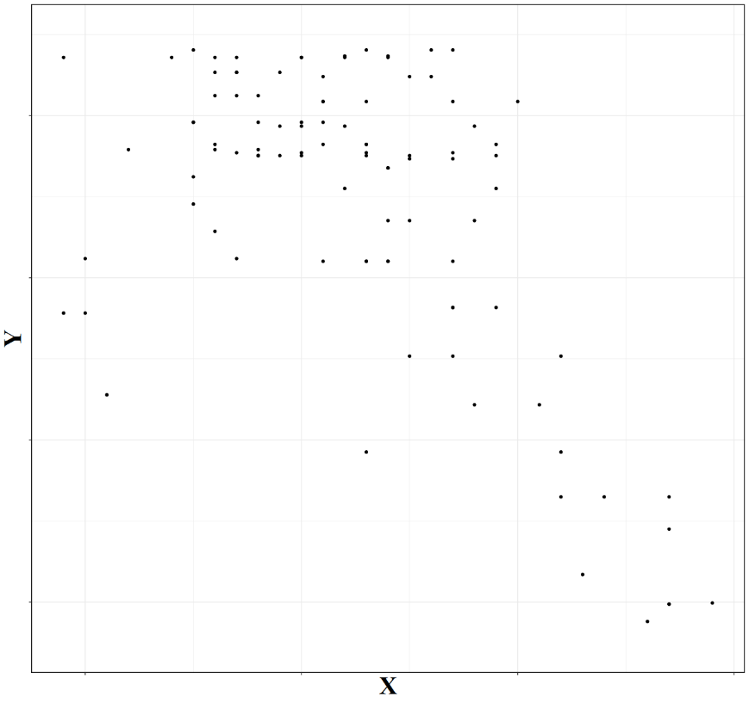
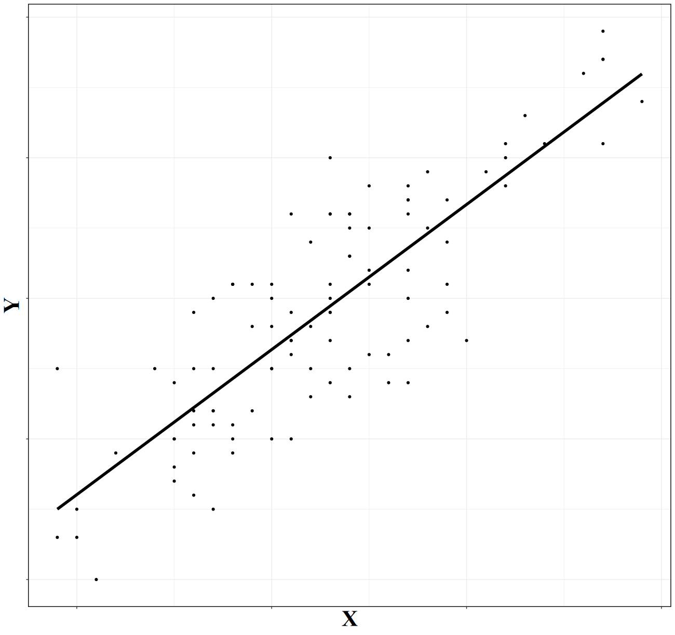
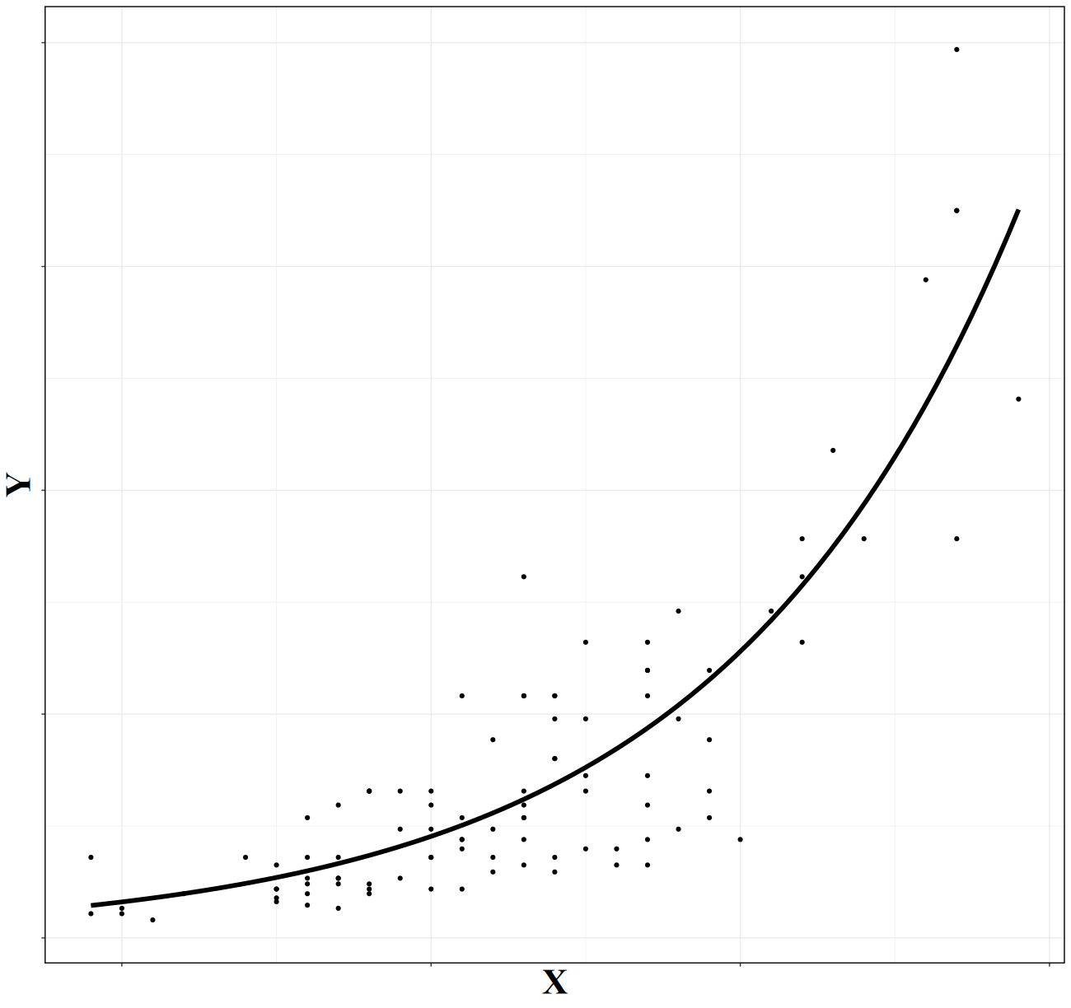
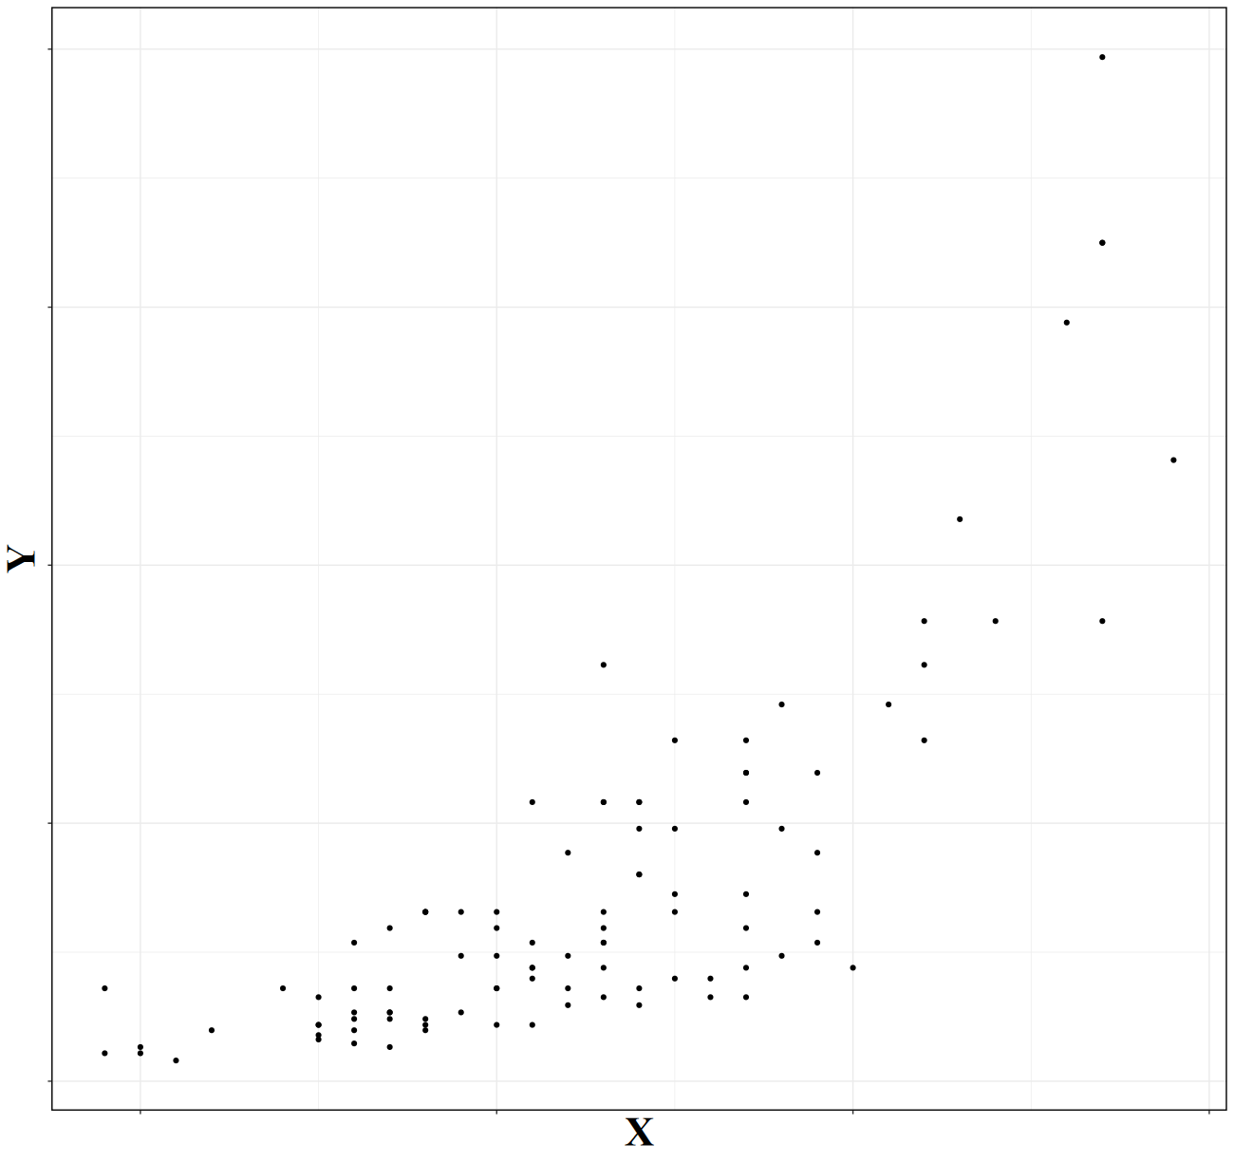
Linear Regression
ordinary Linear Model (LM)
Generalized Linear Model (GLM)
Generalized Additive Model (GAM)

Slide 4
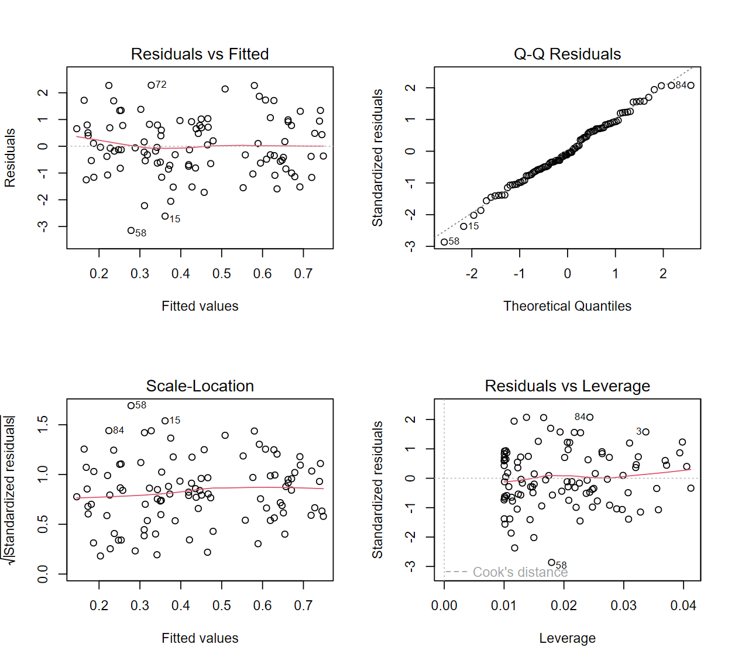
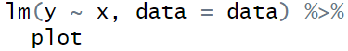

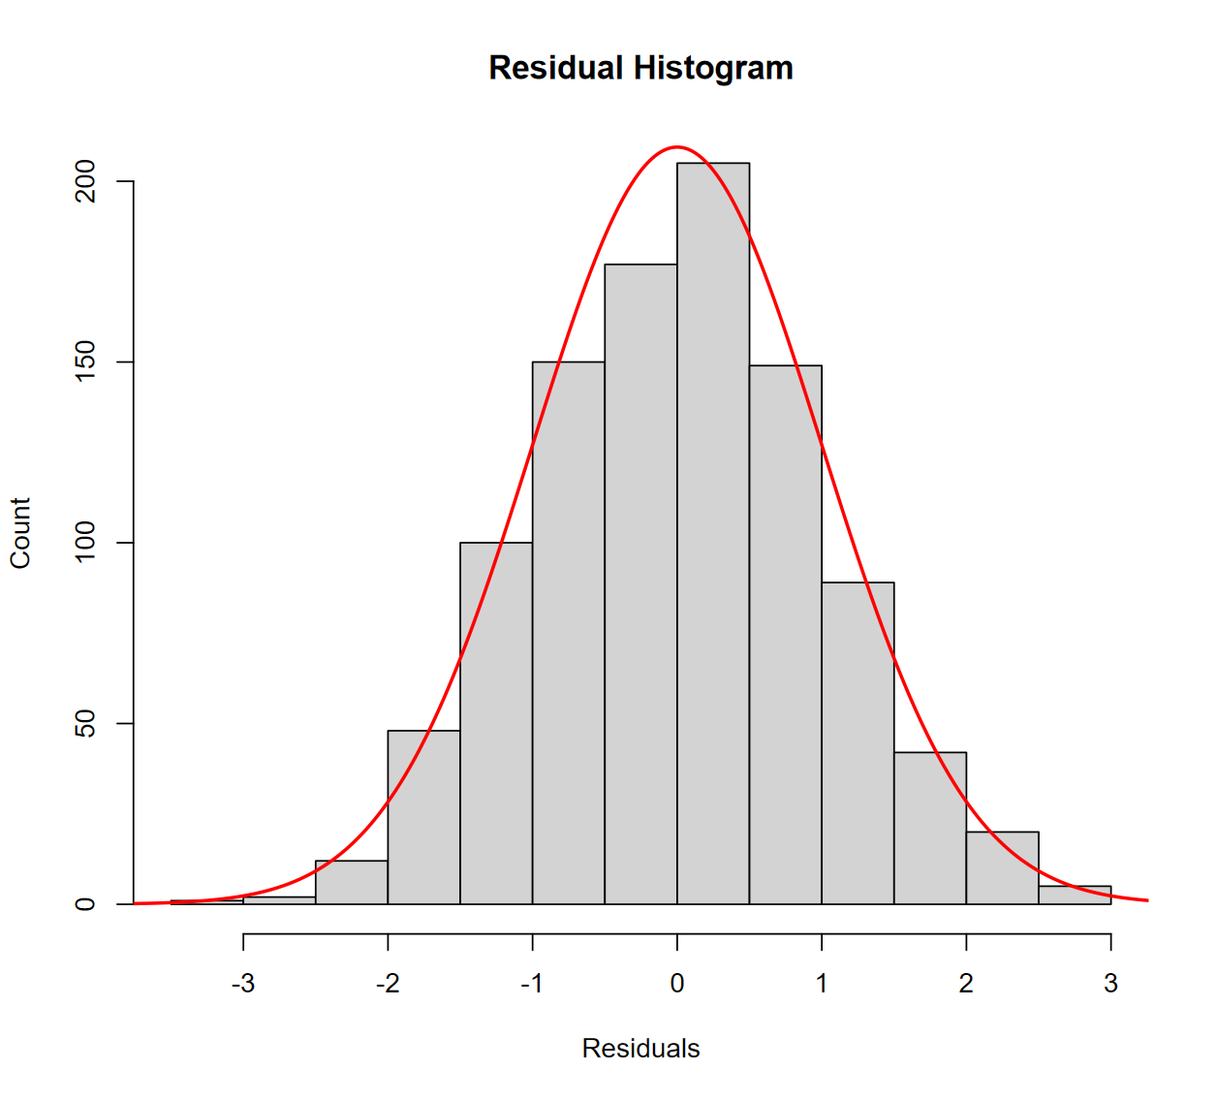
Is it Working??
Many approaches, but…

Slide 5
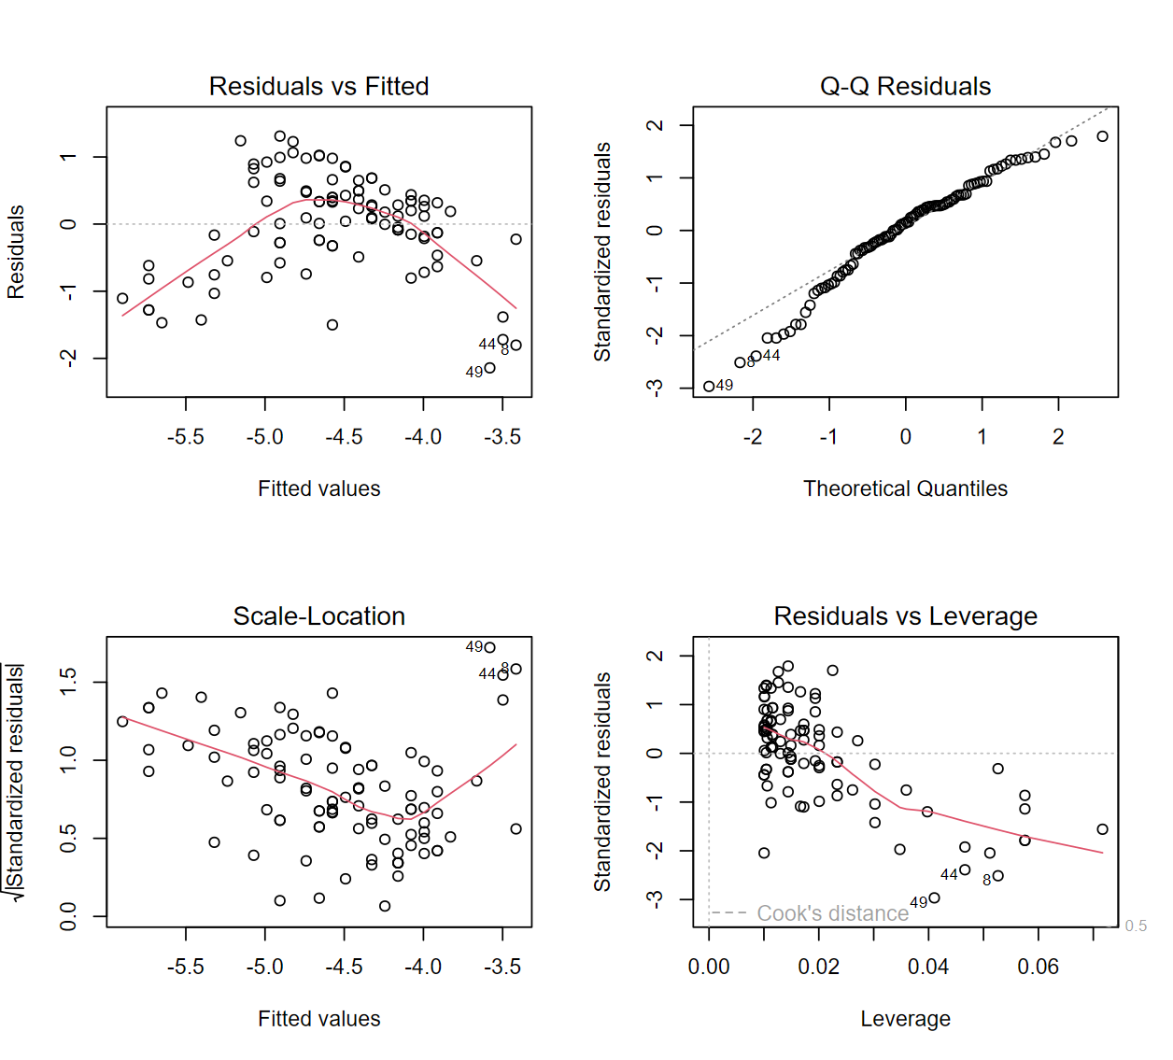
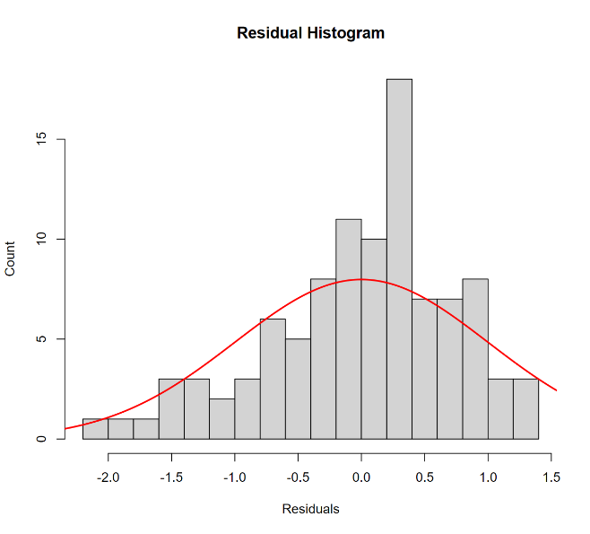
Is it Working??

Slide 6
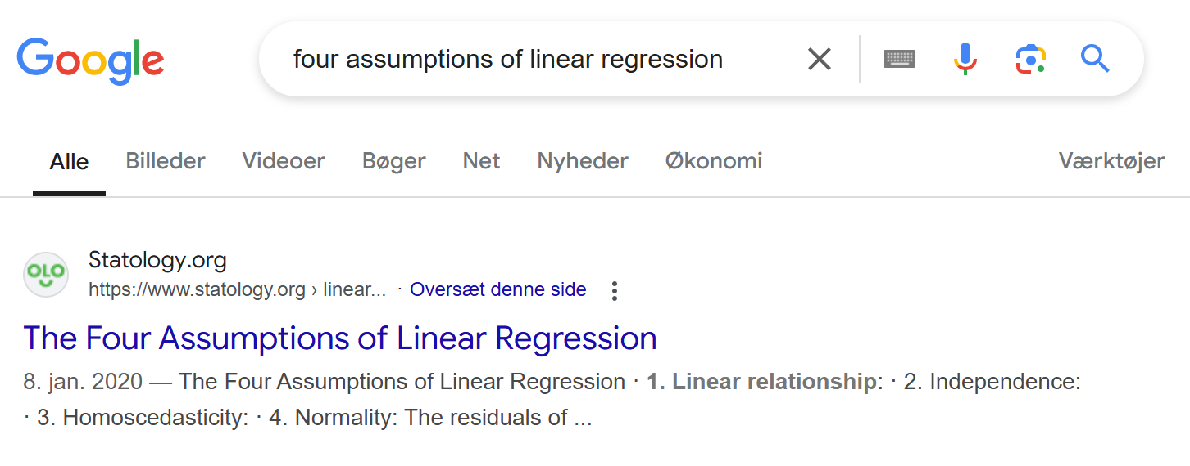
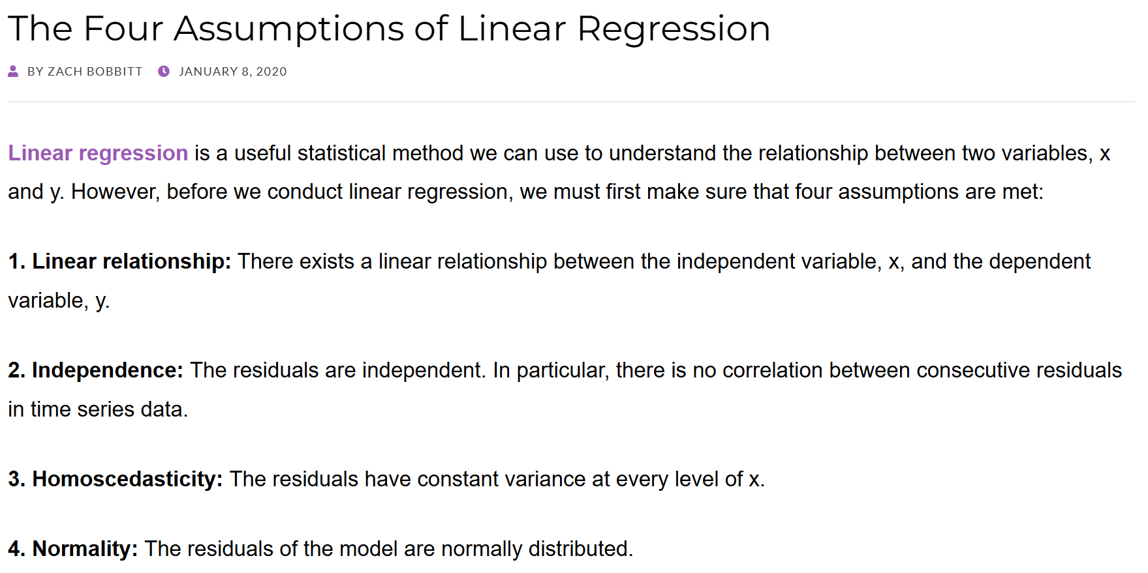
Let’s ask google

Slide 7
Let’s ask google
“”
“”

Slide 8
Is it Working??
Not linear!
Residuals NOT normal
“Unequal variance”
(heteroscedastic)

Slide 9
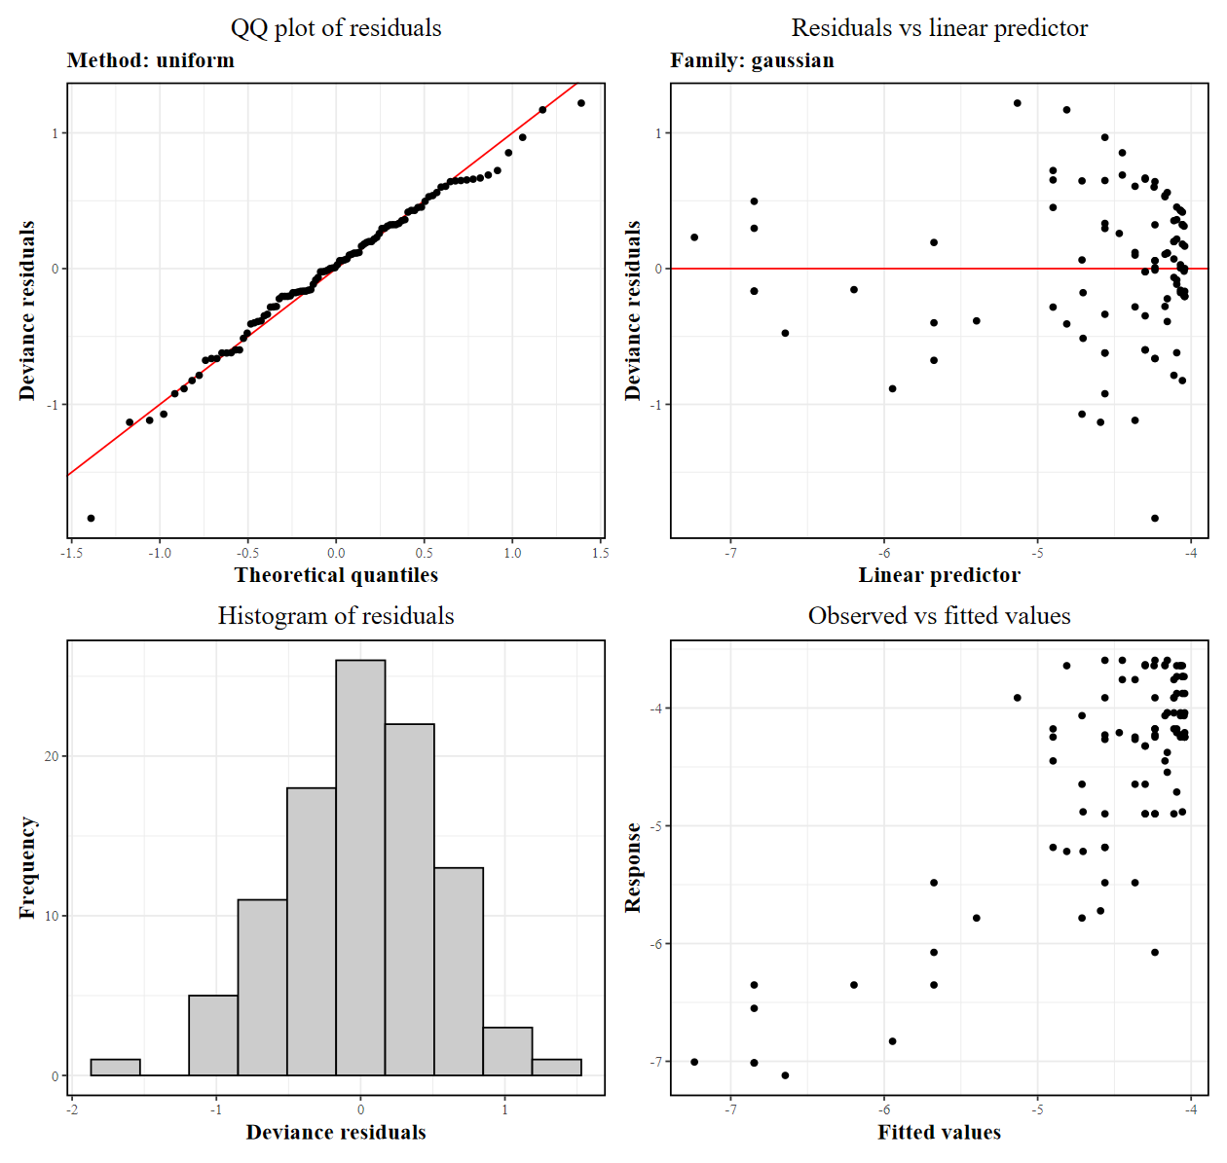


Is it Working?? Now with MGCV
🎉

Slide 10

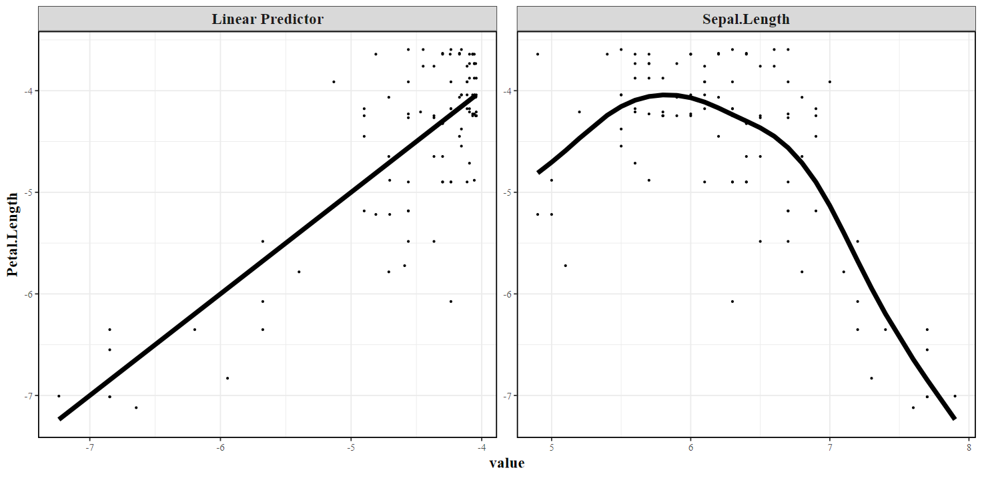
What is A GAM and MGCV?!
 LM
 LMM
 GLM
 GLMM
 GAM
 GAMM

Slide 11
GAM
GAMM
MGCV
GLMM
GLM
LMM
LM

Slide 12
Dissecting a MGCV GAM

Slide 13
Dissecting a MGCV GAM
Bs = “…”: Which type of non-linear relationship? re is the type the functions like random effects, but there are many more
s(…): non-linear predictor(s)
Response ~ Predictors + Random effects

Slide 14
Dissecting a MGCV GAM
Response ~ Predictors + Random effects
Modelling data

Slide 15
Dissecting a MGCV GAM
method = “REML”: Technical detail, don’t worry about it.
If using any s(…) terms, use “REML” otherwise simply omit `method`.
Response ~ Predictors + Random effects
Modelling data
(Estimation method)

Slide 16
Dissecting a MGCV GAM
Response ~ Predictors + Random effects
Modelling data
(Estimation method)
Response family (~type)
family = “…”: Relationship between response and predictor, as well as residual distribution. Like standard glm, but much more powerful.

Slide 17
Dissecting a MGCV GAM
Bs = “…”: Which type of non-linear relationship? re is the type the functions like random effects, but there are many more
method = “REML”: Technical detail, don’t worry about it.
If using any s(…) terms, use “REML” otherwise simply omit `method`.
s(…): non-linear predictor(s)
Response ~ Predictors + Random effects
Modelling data
(Estimation method)
Response family (~type)
family = “…”: Relationship between response and predictor, as well as residual distribution. Like standard glm, but much more powerful.

Slide 18
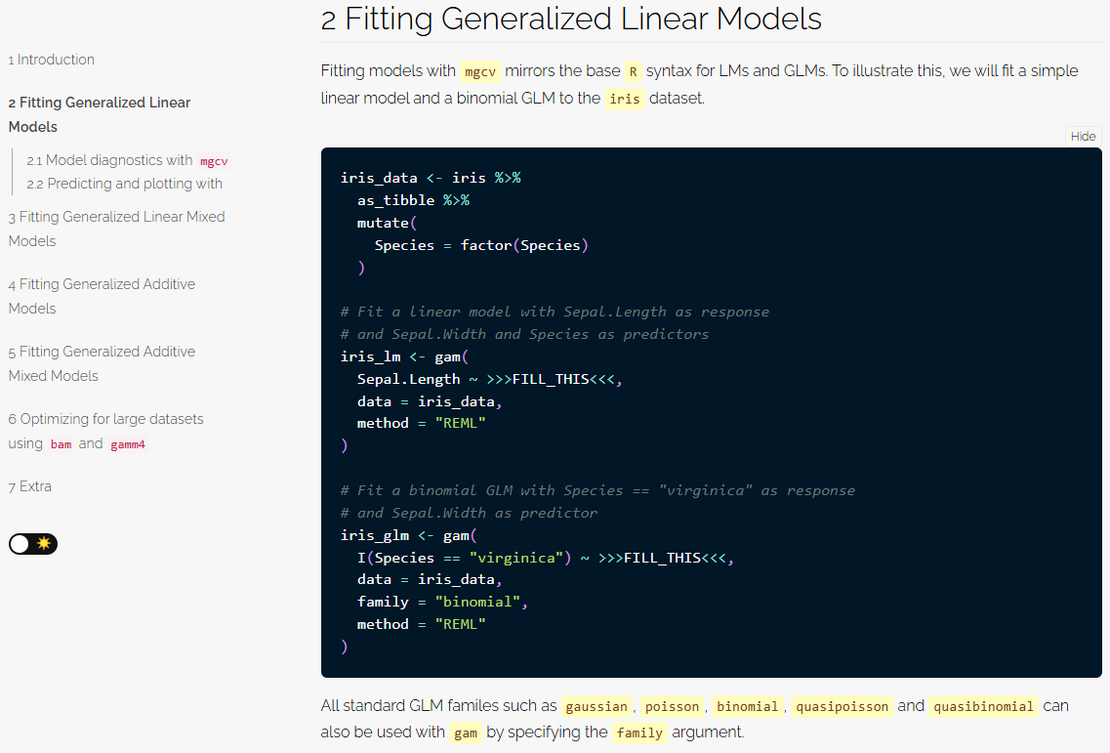
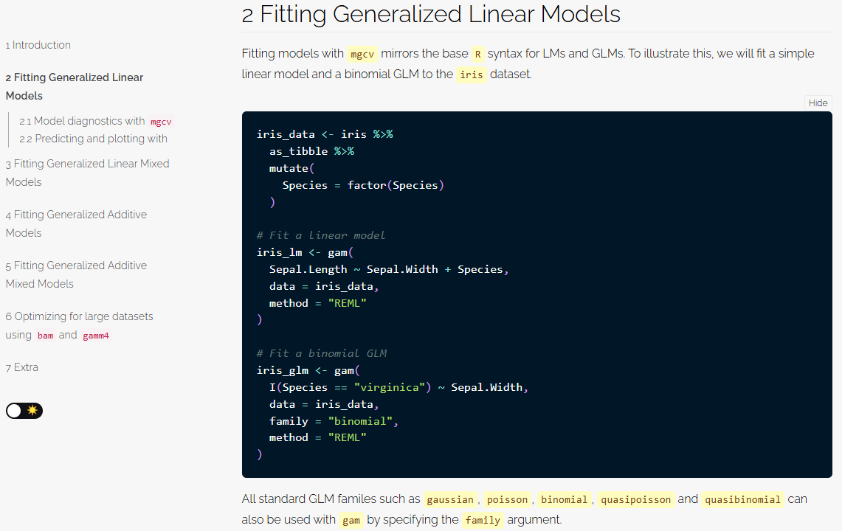
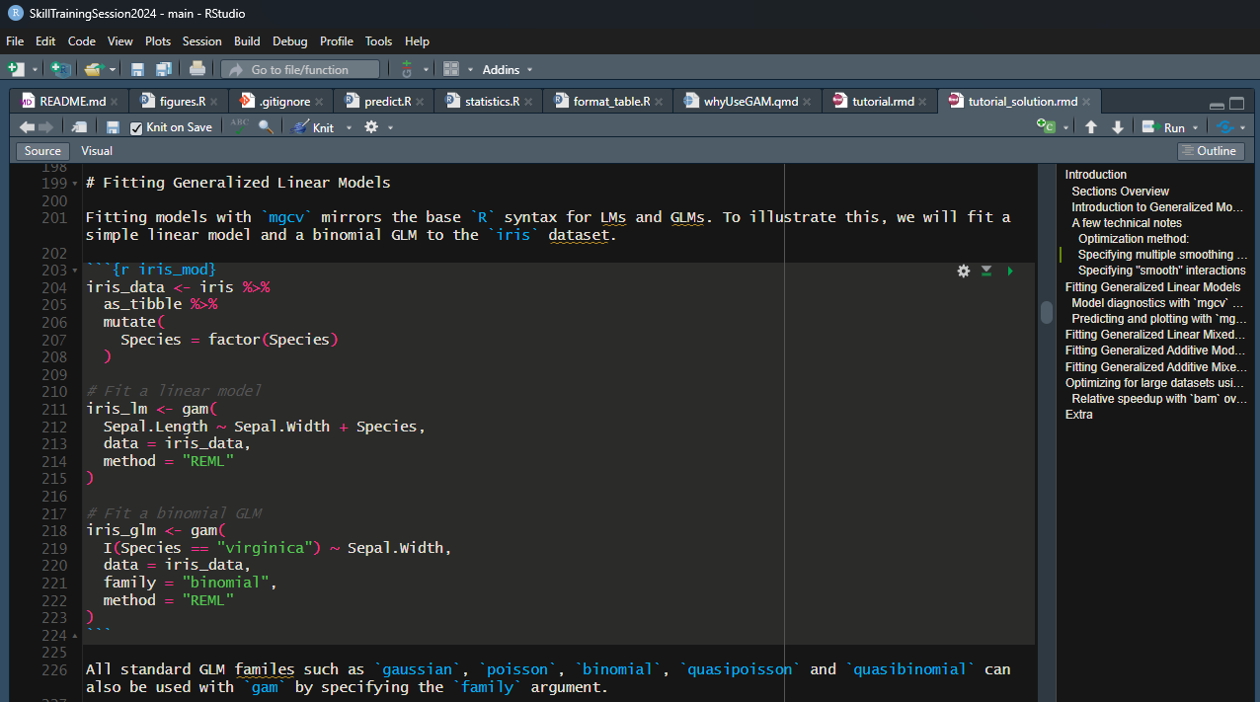
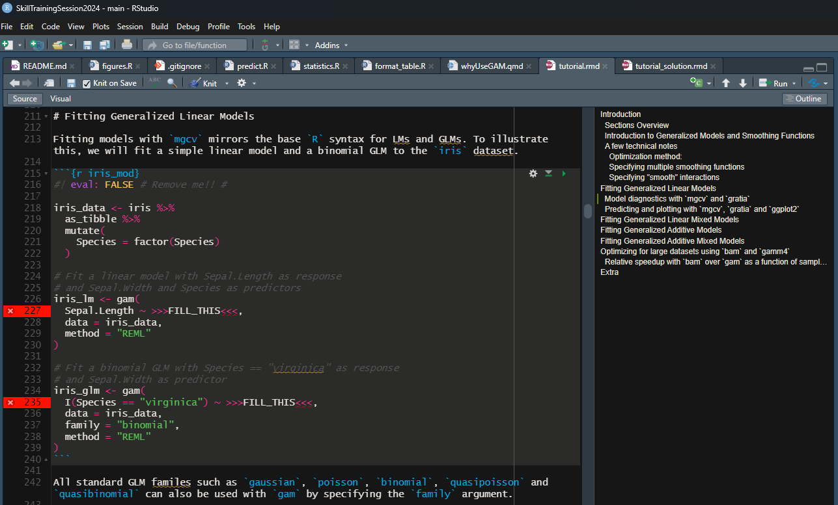
How DO I complete the tutorial?
Code

Slide 19
How DO I complete the tutorial?
Navigation

Slide 20
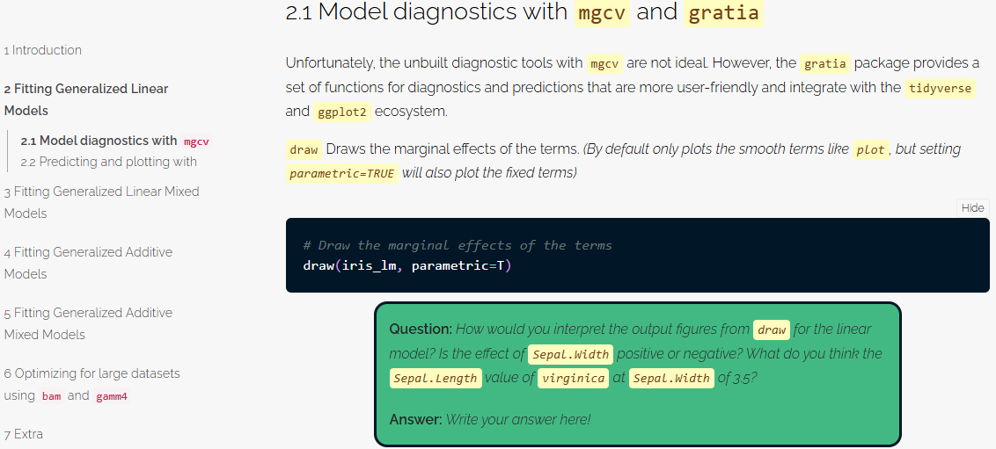
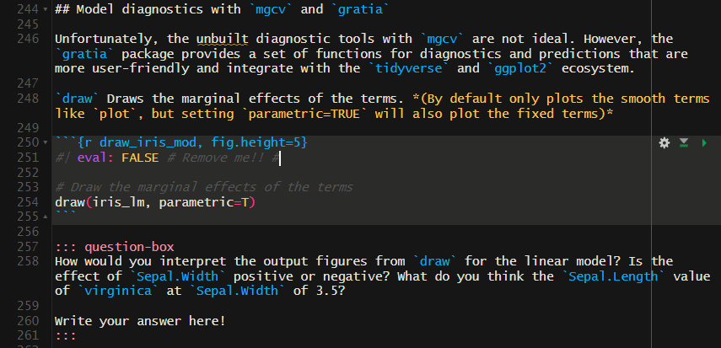
How DO I complete the tutorial?
Questions

Slide 21
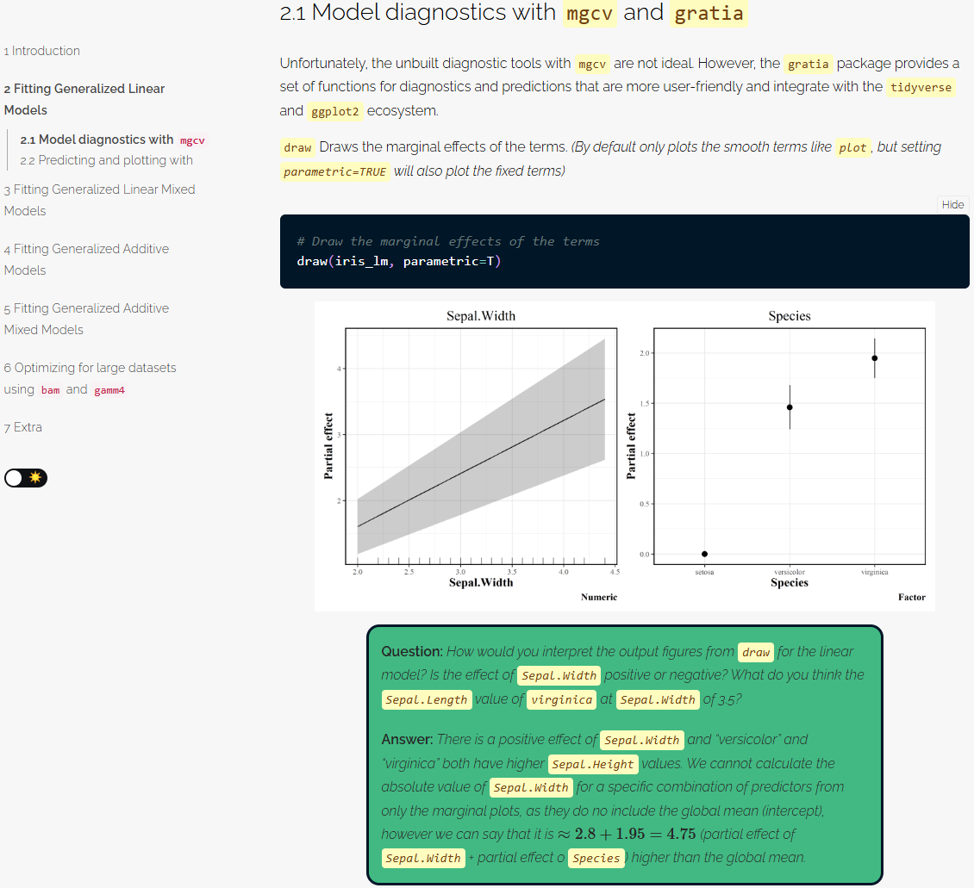
How DO I complete the tutorial?
Questions

Slide 22
Exercise
30 minutes
Pair up
Discuss questions, and solve the problems together
(Later  Explanations of advanced use-cases)

Slide 24
Advanced Usage
MGCV Skill training Session

Slide 25
Families in MGCV
scat (scaled t): For heavy tailed data
ziP (zero-inflated poisson): For count data with excessive zeros
nb (negative binomial): For count data, when poisson is not appropriate
betar (beta regression): For proportion data between, not including, 0 and 1
gaulss (gaussian location-scale): For linear regression, where the variance is non-constant
ziplss (zero-inflated poisson location-scale): For count data, where zeros are modelled separately

Slide 26
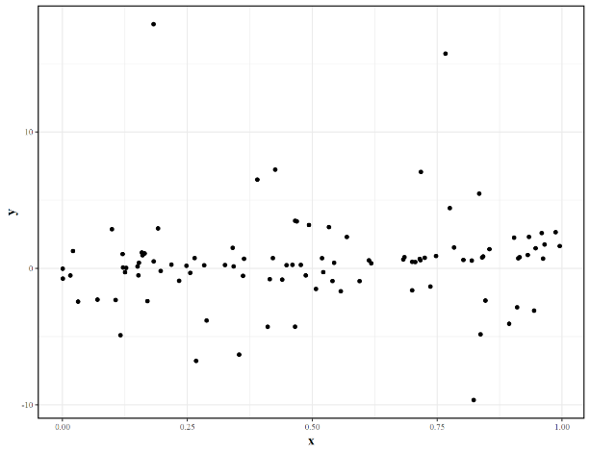
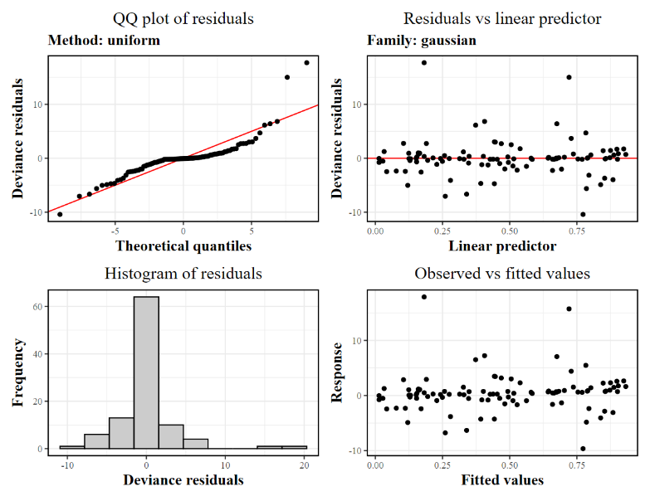
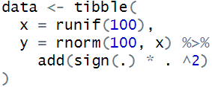
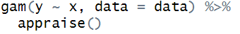
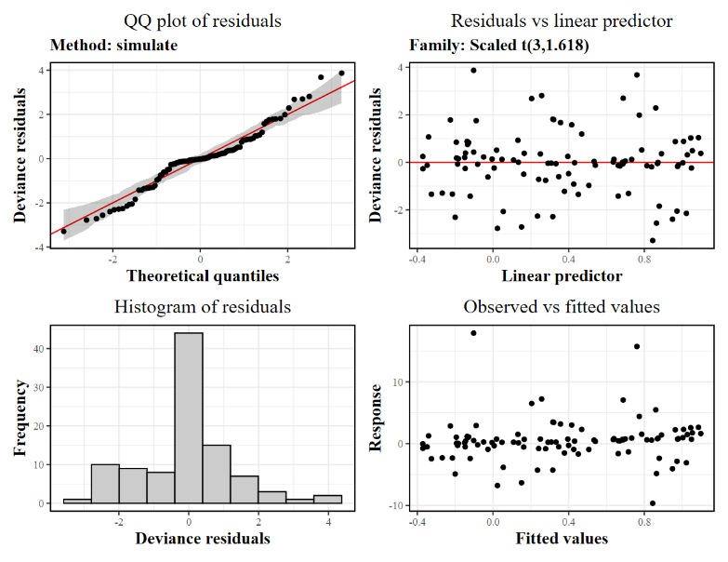
Scaled t
ordinary LM
family = “scat”

Slide 27
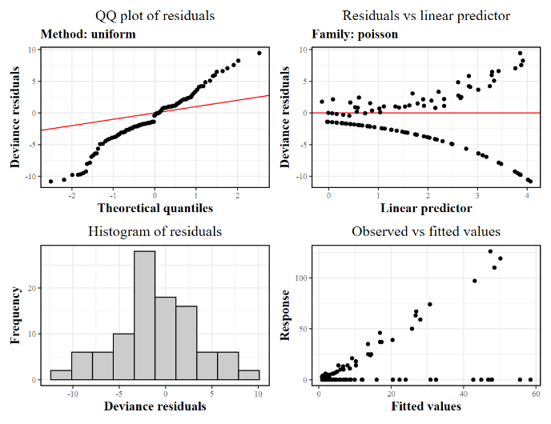
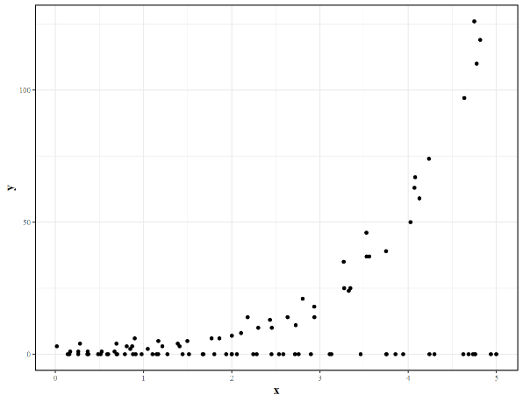
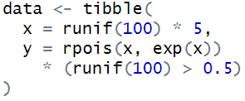
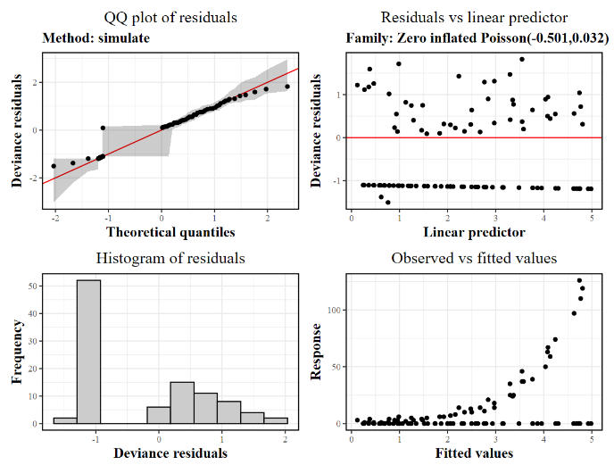
Zero-inflated Poisson
family = “poisson”
family = “ziP”

Slide 28
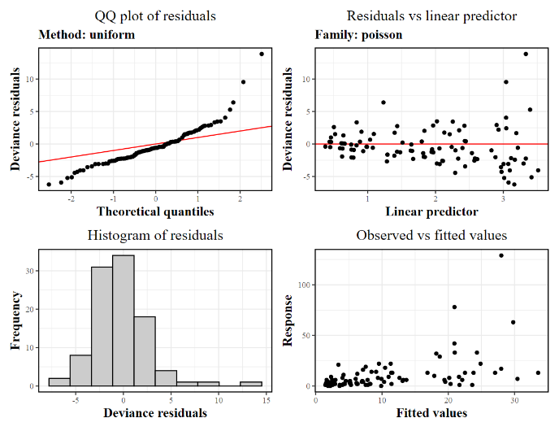
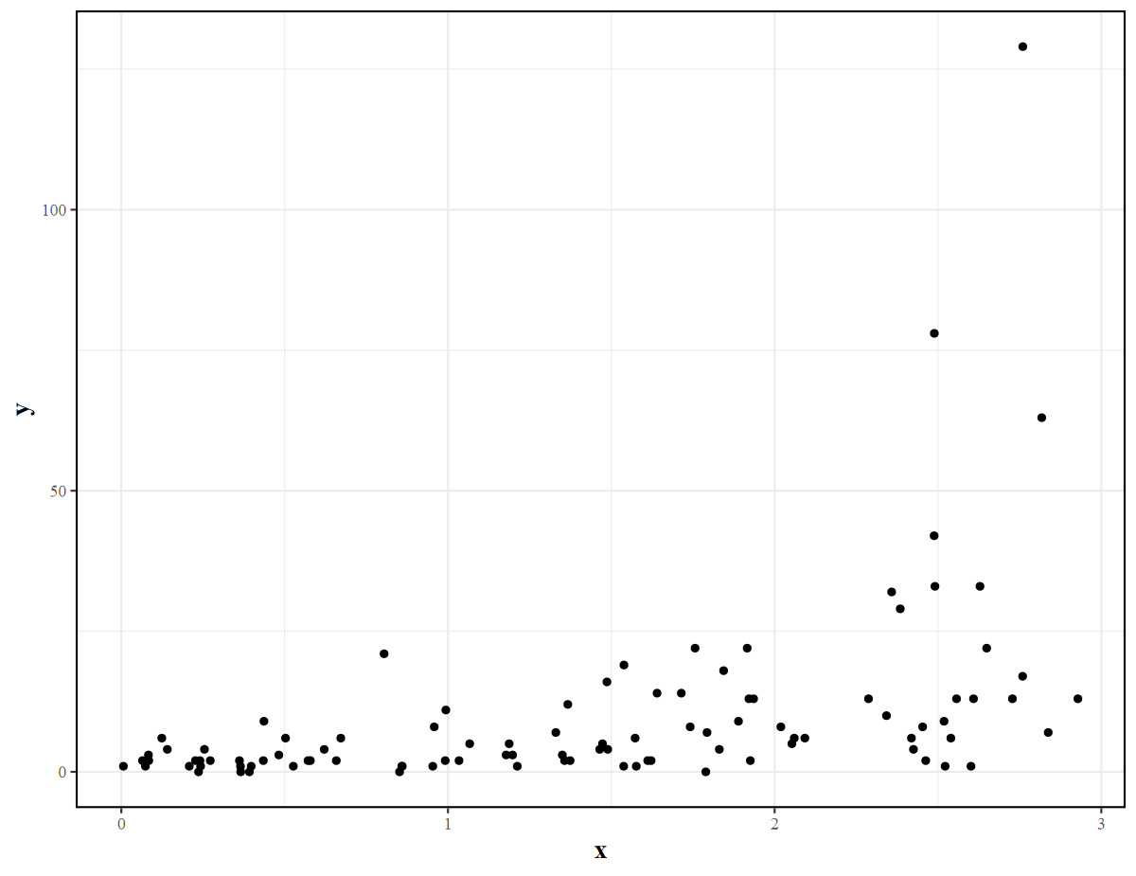
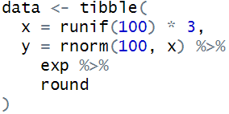
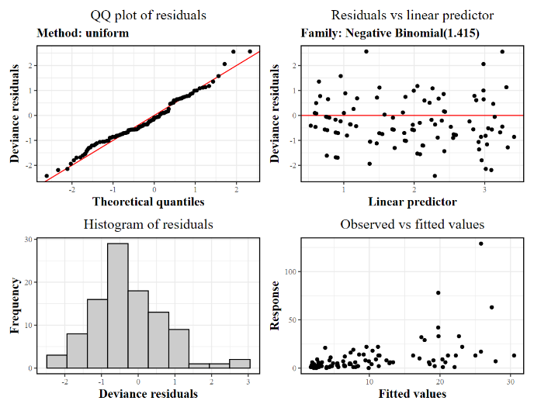
Negative Binomial
family = “poisson”
family = “nb”

Slide 29
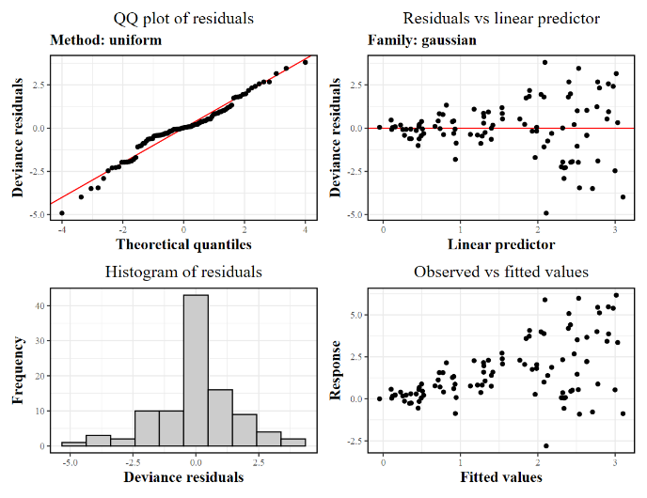
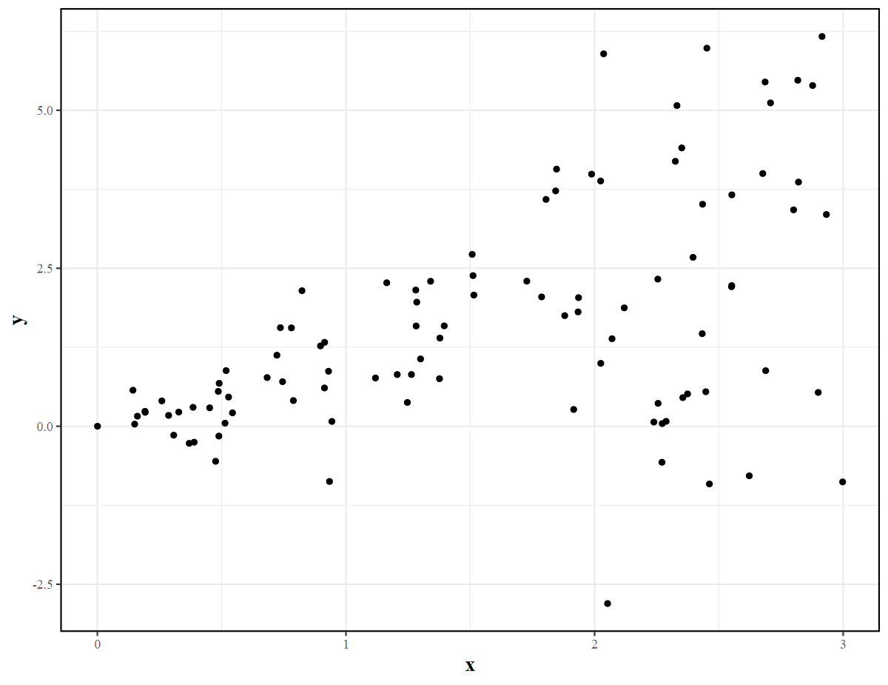
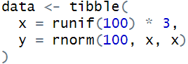
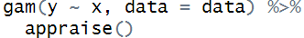
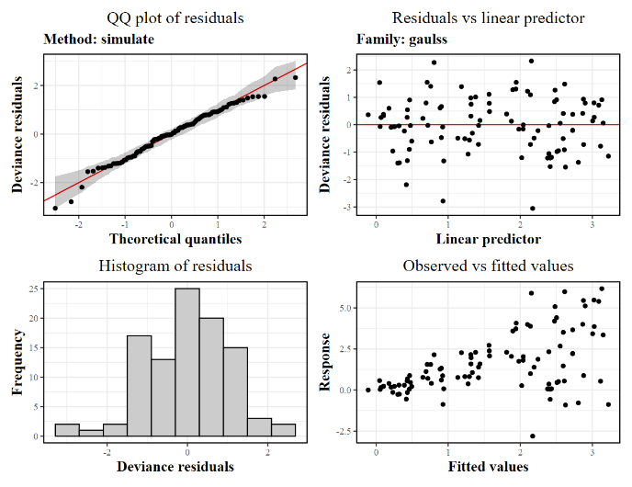
Gaussian Location-scale
Ordinary LM
family = “gaulss”

Slide 30
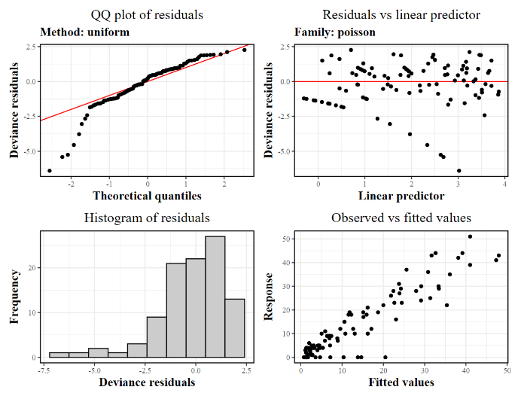
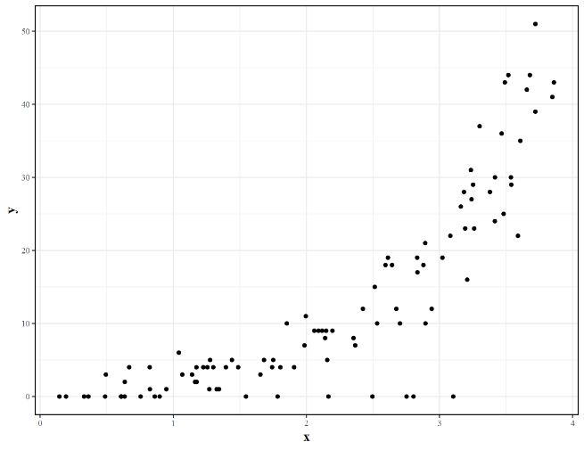
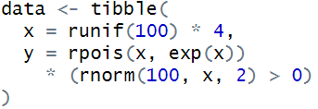
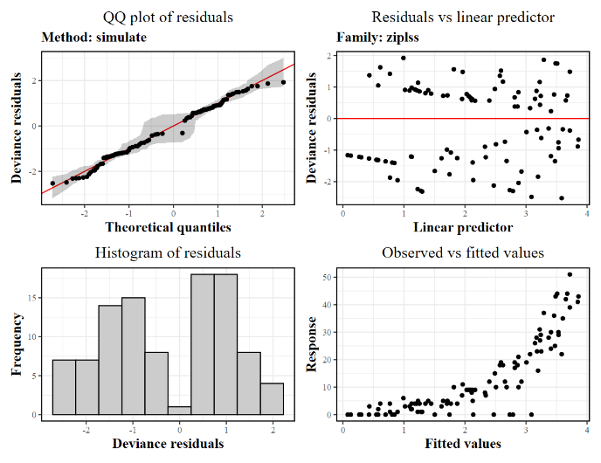
Zero-inflated Poisson location-scale
family = “poisson”
family = “ziplss”

Slide 31
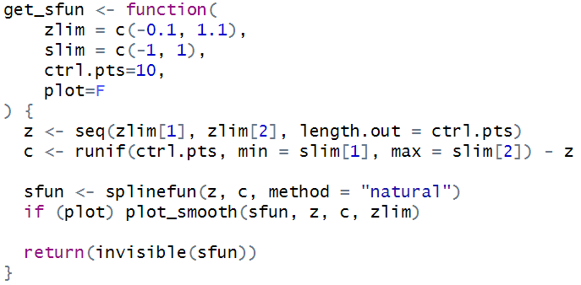
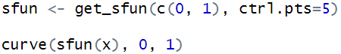
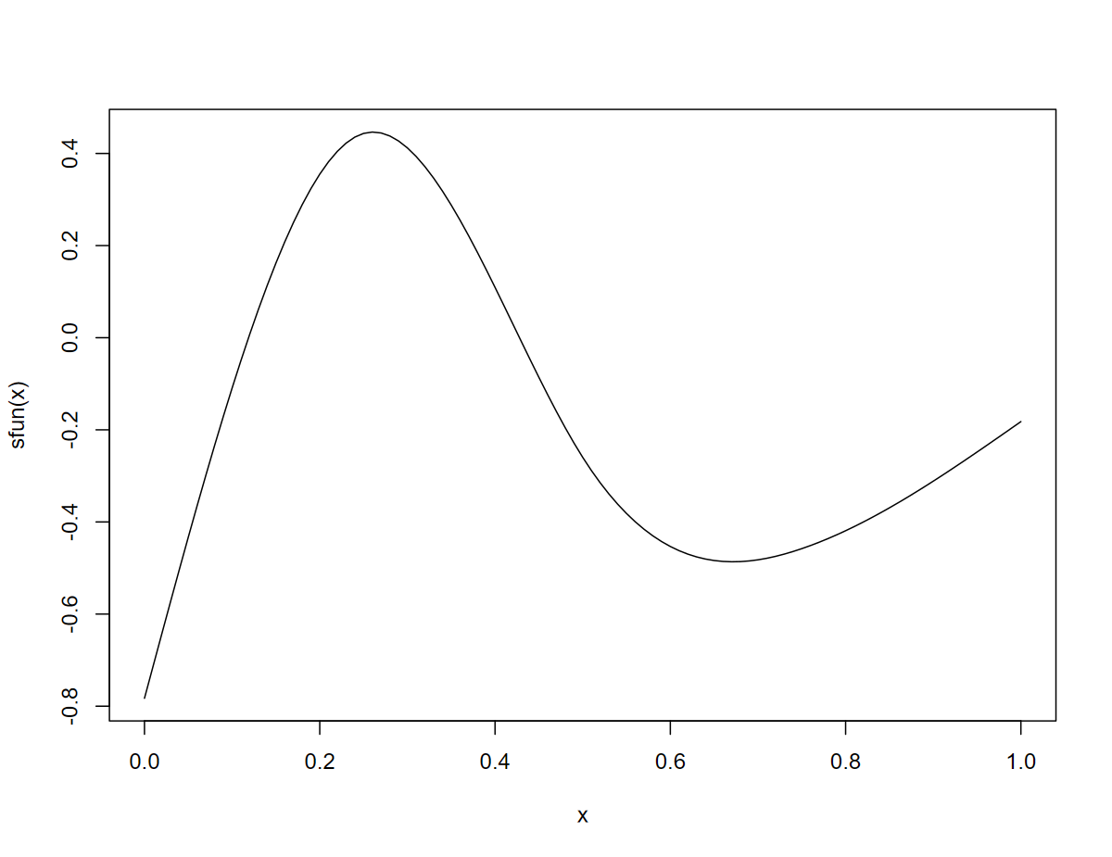
SMOOTH TERMS
tp (thin-plate splines): default smooth
cr (cubic spline): old-school smooth
ts/cs: shrinkage versions of tp/cr; smooth can have no effect
cc (cyclic cubic): matches the “ends”, useful for e.g. time-of-day/year
re (random effect): similar to a normal factor term, but uses fewer degrees of freedom
fs (random factor smooth): for the case where there are multiple similar, but not equal, non-linear relationships for different factor levels (groups)

Slide 32
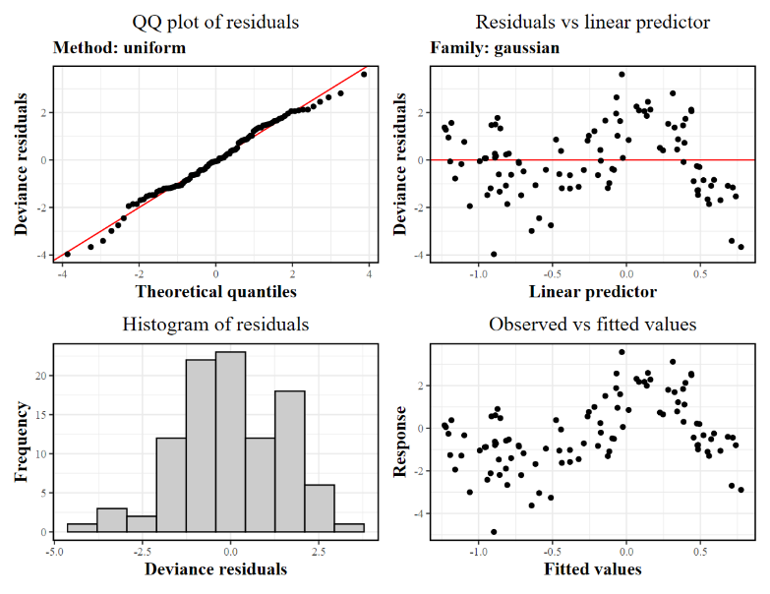
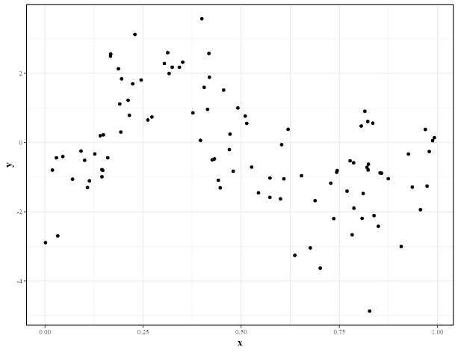
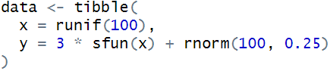

Thin-plate Splines
ordinary LM
family = “scat”

Slide 33




Shrinkage Splines
bs = “tp”
bs = “ts”

Slide 34


STANDARD
SHRINKAGE
bs = “tp”
bs = “ts”

Slide 35




Cyclic Splines
bs = “cr”
bs = “cc”

Slide 36


Slide 37




Random EffectS
bs = “cr”
bs = “cc”

Slide 38




Random Factor Smooth
bs = “tp”
Interaction + bs = “fs”

Slide 39

Multiple Independent Smooths

Slide 40

INDEPENDENT SMOOTHS
RANDOM FACTOR SMOOTHS
DEFAULT SMOOTH

Slide 41
Interactions
s(x, y, bs = “…”) | Simple, but covariates must use the same smooth type and preferably be on the same(ish) scale.
te(x, y, bs = c(“…”, “…”)) | More powerful, but results are aggregated.
s(x, bs = “…”) + s(y, bs = “…”) + ti(x, y, bs = “…”) | Almost as performant as the prior approaches, but much easier to interpret formula and outputs!

Slide 42

More diagnostics and marginal plots
S(…, k = X) | “k” is often a very important parameter. It specifies the maximum degrees of freedom a specific smooth term may use.
The only downside to increasing “k” is that it is slower!

Slide 43


Slide 44




Gam.check

